Slide 1


Social Buzz: Scaling for Growth and IPO Success
Shruti Sahrawat
Data Analyst
22-12-2024

Slide 2


Today's agenda
Project recap-
Audit of Big Data practices
IPO preparation guidance
Analysis of top 5 content categories based on user engagement
Problem-
Social Buzz is struggling to manage its rapidly growing unstructured data from 100,000+ daily content pieces. They need external expertise to scale operations and prepare for an upcoming IPO.
The Analytics team-
Andrew Fleming (Chief Technical Architect), Marcus Rompton (Senior Principle), and Myself(Data Analyst).
Process-
I merged data from multiple sources, including user reactions and content details, to create a comprehensive dataset. Then, I analyzed the data to identify the top 5 content categories based on user engagement and reaction scores.
Insights-
The analysis revealed the top 5 content categories driving the highest user engagement, providing valuable insights for improving content strategy and supporting scaling efforts for the IPO.
Summary-
I analyzed Social Buzz's user reaction data to identify top-performing content categories, aiding in their strategic decision-making for scaling and IPO preparation.

Slide 3

Client Background:
Social Buzz, founded in 2010, is a rapidly growing social media platform with 500 million active users monthly, focusing on anonymous user reactions to content.
Business Challenge:
The company generates over 100,000 pieces of unstructured content daily and needs expertise to manage big data and prepare for its IPO.
Project Objectives:
Audit of Big Data practices
IPO preparation guidance
Analysis of top 5 content categories based on user engagement.
Project Recap

Slide 4


Problem:
Social Buzz was struggling to manage and analyze the vast amount of unstructured data generated from over 100,000 content pieces uploaded daily. The company needed to identify the top-performing content categories to enhance user engagement and effectively scale operations in preparation for an upcoming IPO.

Slide 5



Andrew Fleming
(Chief Technical Architect)
The Analytics team
Marcus Rompton
(Senior Principle)
Myself
(Data Analyst)

Slide 6
Process
I integrated and cleaned data from the Reaction, Content, and Reaction Types tables to ensure accuracy. Then, I analyzed user engagement scores across content categories to identify the top 5 performing categories.
I visualized the results and provided insights to guide content strategy and IPO preparations.
1 Data Integration
2 Data Cleaning
3 Category Analysis
4 Data Visualization
5 Insights and Recommendations

Slide 7

Insights
The top 5 content categories with the highest user engagement were identified, helping Social Buzz understand user preferences and improve content strategy.
Engagement patterns highlighted the types of content that drive positive reactions, enabling targeted content optimization.
These insights support Social Buzz’s scaling efforts and IPO preparation by informing data-driven decisions to enhance user engagement and retention.

Slide 8
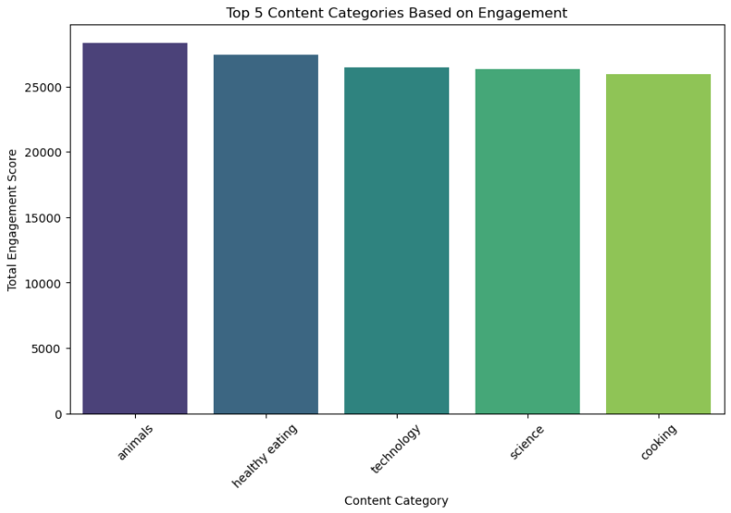
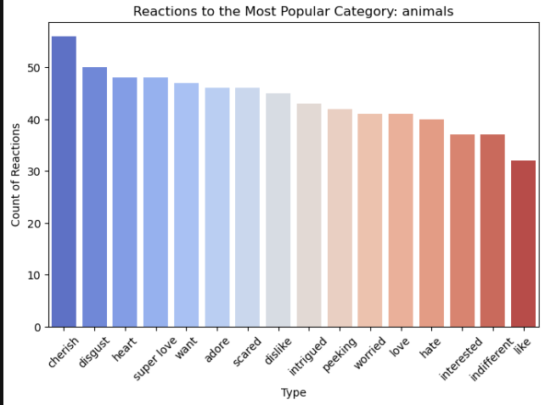
Data Visualizations

Slide 9
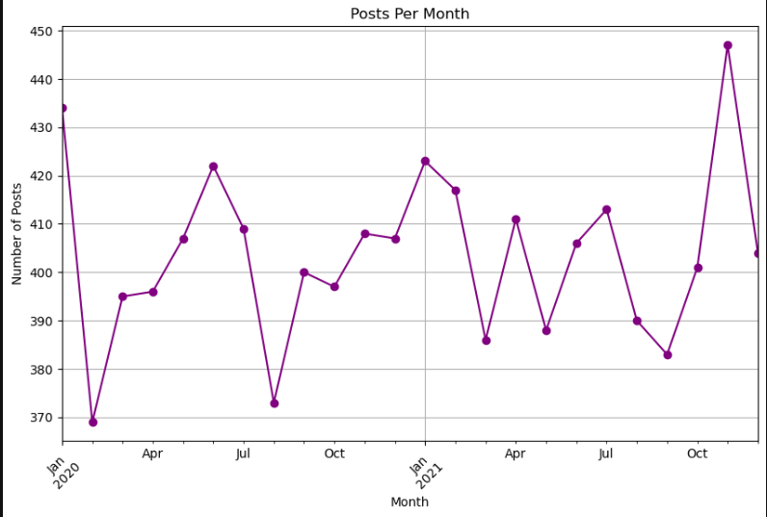

Slide 10

Summary
I analyzed Social Buzz's user reaction data to identify the top 5 content categories based on engagement scores. This analysis provided valuable insights into user preferences and content performance. The findings helped inform content strategy and support scaling efforts for the company's upcoming IPO.

Slide 11

Thank you!
ANY QUESTIONS?

